Slide 1


AN ENHANCED MULTIMODAL BIOMETRIC SYSTEM BASED ON CONVOLUTIONAL NEURAL NETWORKS
Improving Authentication with Fingerprint and Iris Recognition

Slide 2
PRESENTED
BY :
Rishi Joshi
Mayank Bhardwaj
Palak Wadhwani
Suman Thakur

Slide 3

TABLE OF CONTENT
Introduction
Problem Statement
Methodology
Key Findings
Discussion
Conclusion
Future work

Slide 4
INTRODUCTION
Biometric authentication is widely used for secure identity verification in various applications, including banking, healthcare, and border control. However, unimodal biometric systems relying on a single biometric trait, such as fingerprint or iris, face challenges related to accuracy, spoofing, and environmental factors.
Multimodal biometric systems, which combine multiple biometric modalities, offer improved security and reliability by leveraging complementary information. This study explores the integration of fingerprint and iris biometrics using CNN-based feature extraction and fusion to enhance authentication performance.

Slide 5
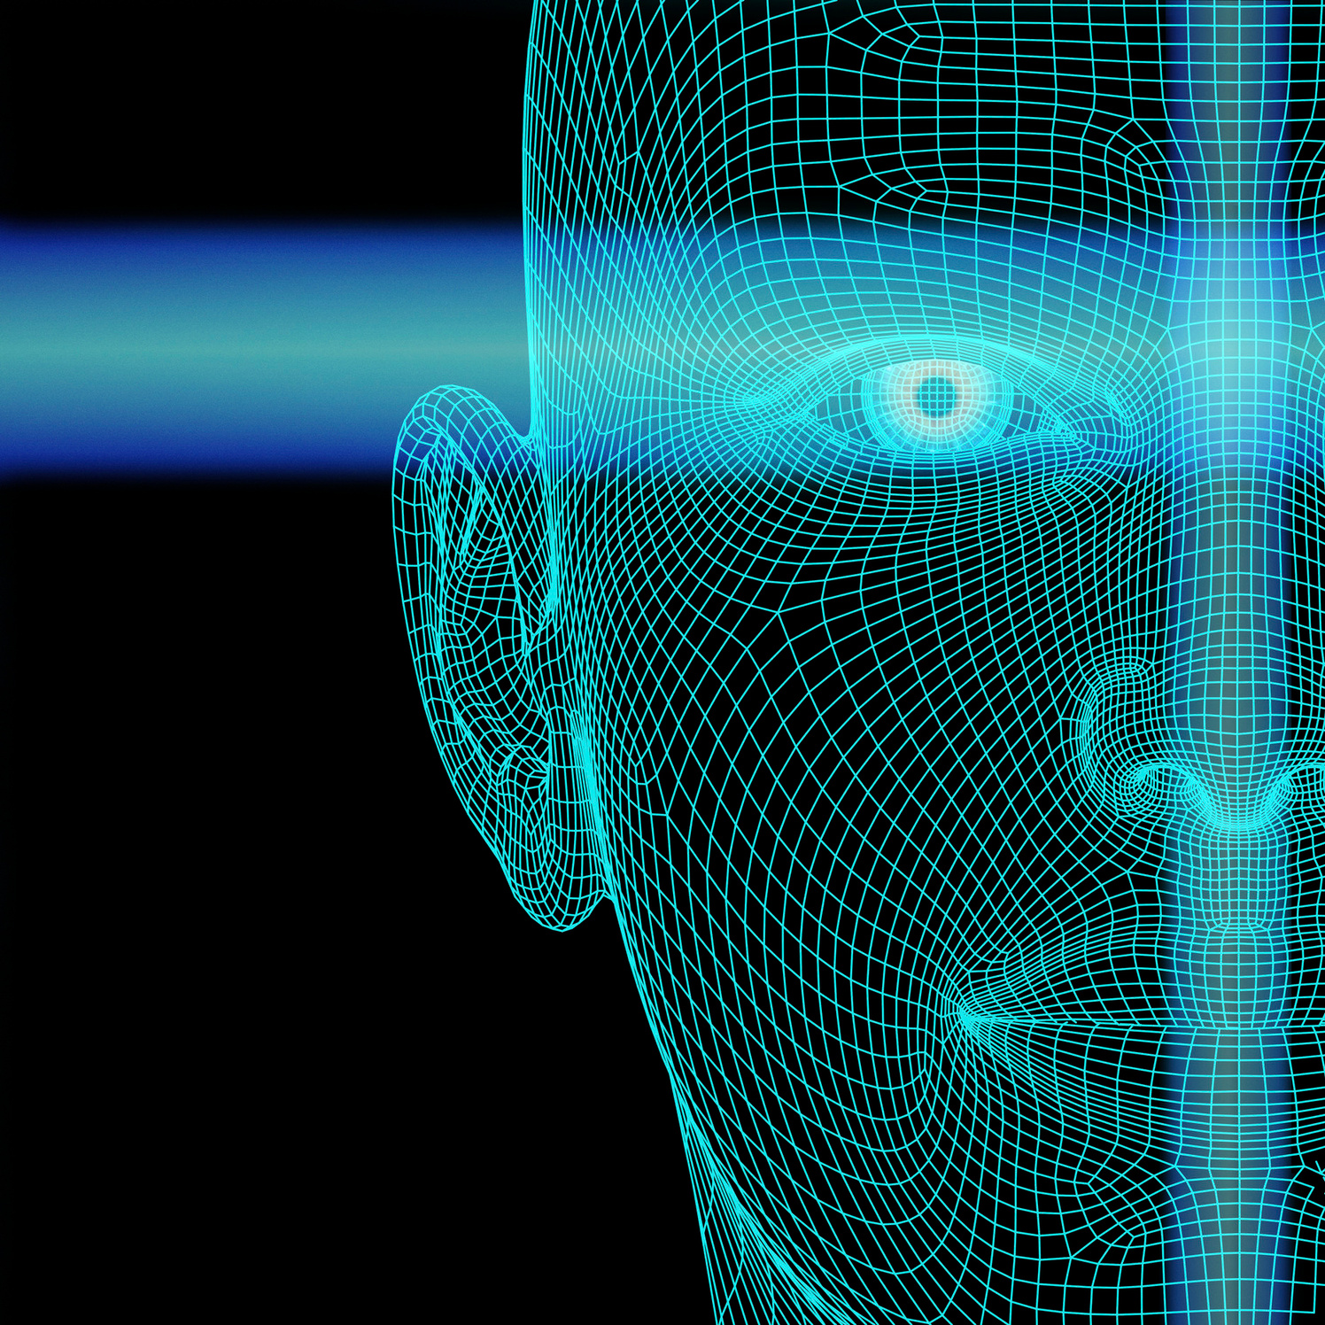

Traditional unimodal biometric authentication systems (using only fingerprint or iris recognition) suffer from several limitations:
Vulnerability to Spoofing Attacks – A single biometric trait can be easily faked (e.g., artificial fingerprints, high-resolution iris images).
High False Acceptance Rate (FAR) & False Rejection Rate (FRR) – Environmental factors like poor lighting, dirty fingers, or occlusions degrade accuracy.
Lack of Robustness – Unimodal systems fail in cases where a biometric trait is damaged, altered, or unavailable (e.g., injuries affecting fingerprints).
Limited Generalization in Deep Learning Models – Traditional CNN-based models for single biometric modalities may struggle with overfitting or misclassification in real-world conditions.
Lack of Explainability – Most AI-based biometric systems act as black boxes, making it difficult to understand how decisions are made.
PROBLEM STATEMENT

Slide 6

RESEARCH OBJECTIVES
Develop a CNN-based multimodal biometric system integrating fingerprint & iris recognition.
Enhance accuracy & security through feature fusion techniques.
Use Grad-CAM for model interpretability, ensuring transparency.
Address limitations of existing biometric systems using deep learning.

Slide 7
OVERVIEW OF TRADITIONAL BIOMETRIC SYSTEMS
FEATURE EXTRACTION + MACHINE LEARNING CLASSIFIERS:
Support Vector Machines (SVM), K-Nearest Neighbors (KNN).
Require manual feature engineering.
Performance limited by poor feature selection
CHALLENGES:
❌Cannot automatically learn complex patterns.
❌ Handcrafted features may not generalize well.
❌ Not robust against variations in input images.

Slide 8
DEEP LEARNING-BASED BIOMETRIC SYSTEMS
WHY USE CNNS?
Extracts deep hierarchical features from images.
Eliminates need for manual feature engineering.
Achieves high accuracy in image classification tasks.
EXISTING APPROACHES:
CNN for fingerprints (high accuracy but single-modality).
CNN for iris recognition (sensitive to occlusions & blurriness).
Lack of effective multimodal fusion in deep learning biometrics.

Slide 9

01
Robust multimodal fusion techniques.
RESEARCH GAP
02
Explainability (why did the model make a decision?).
Existing biometric models lack:
03
Adaptability to real-world conditions (occlusions, distortions).

Slide 10

OUR PROPOSED SOLUTION
✅ CNN-based multimodal system integrating fingerprint & iris.
✅ Uses deep learning feature fusion for better classification.
✅ Implements Grad-CAM for visualization & interpretability.

Slide 11
METHODOLOGY
Dataset Preparation
Datasets Used:
Public biometric datasets for fingerprint & iris images.
Grayscale conversion for consistency.
Resizing (128×128 pixels) to standardize inputs.
Data Augmentation (rotation, noise addition) to improve generalization.
Preprocessing Steps:
Grayscale conversion for consistency.
Resizing (128×128 pixels) to standardize inputs.
Data Augmentation (rotation, noise addition) to improve generalization.

Slide 12
CNN ARCHITECTURE FOR FINGERPRINT & IRIS RECOGNITION
Dual CNN Architecture:
One CNN branch for fingerprint recognition.
One CNN branch for iris recognition.
Grayscale conversion for consistency.
Resizing (128×128 pixels) to standardize inputs.
Data Augmentation (rotation, noise addition) to improve generalization.
CNN Layers:
Convolution + ReLU + Max Pooling for feature extraction.
Fully connected layers for classification.
Softmax activation for final decision.

Slide 13
FEATURE FUSION APPROACH
Why fuse fingerprint & iris features?
Each biometric has unique discriminative power.
Combining them enhances robustness & security.
Grayscale conversion for consistency.
Resizing (128×128 pixels) to standardize inputs.
Data Augmentation (rotation, noise addition) to improve generalization.
Fusion Techniques:
Feature-level fusion (combining raw features before classification).
Score-level fusion (combining confidence scores after classification).
Chosen Method: Feature-level fusion for richer representations.

Slide 14
MODEL TRAINING & EXPERIMENTAL SETUP
Training Details:
80% Training, 20% Testing split.
Loss Function: Categorical Cross-Entropy.
Optimizer: Adam for efficient learning.
Batch Size: 32, Learning Rate: 0.001.
Grayscale conversion for consistency.
Resizing (128×128 pixels) to standardize inputs.
Data Augmentation (rotation, noise addition) to improve generalization.
Hardware Used:
GPU-based training for acceleration

Slide 15
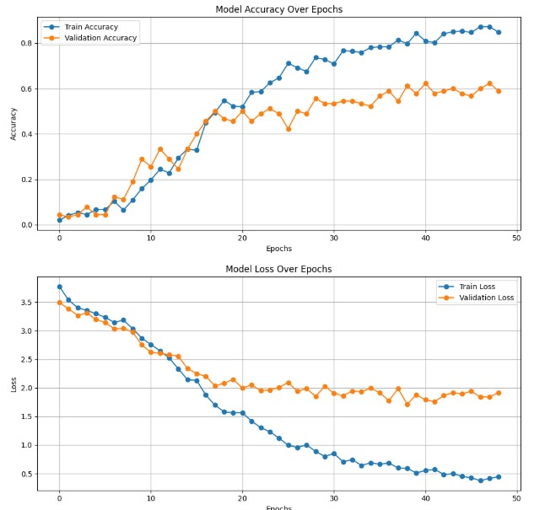

Slide 16
RESULTS & DISCUSSION
PERFORMANCE METRICS
Evaluation Metrics:
✅ Accuracy
✅ Precision, Recall, F1-Score
RESULTS
Classification Accuracy: 80%
Weighted Avg F1-score: 0.80
Best-performing classes: Class 8, 9, 10, 13.
Misclassified cases: Class 14 misclassified as Class 5.

Slide 17
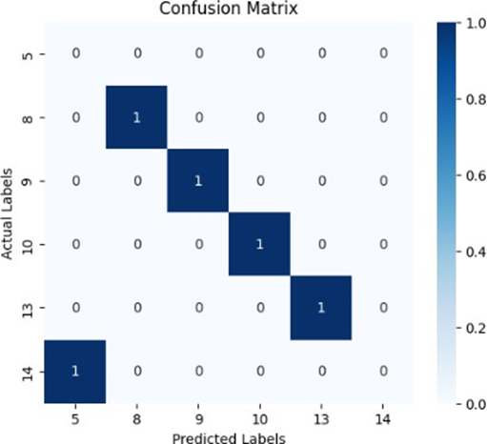
CONFUSION MATRIX ANALYSIS
OBSERVATIONS
Strong classification in clear fingerprint & iris samples.
Some overlap in similar-looking biometric features.

Slide 18
GRAD-CAM VISUALIZATIONS FOR MODEL EXPLAINABILITY
What is Grad-CAM?
Gradient-weighted Class Activation Mapping.
Highlights important regions in fingerprint & iris images.
Findings:
Fingerprint: Ridge patterns were key discriminative features.
Iris: Inner iris boundary & pupil variations were crucial.

Slide 19
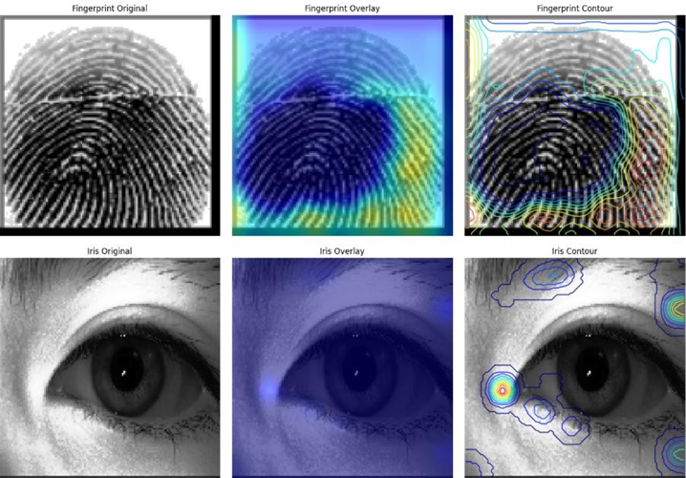

Slide 20
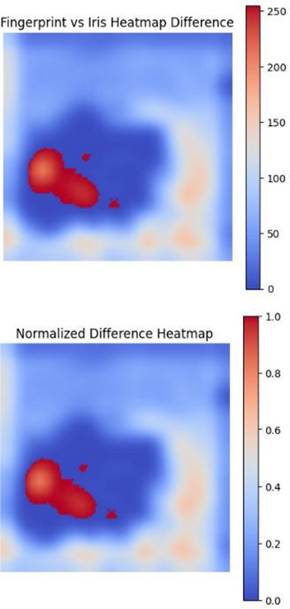
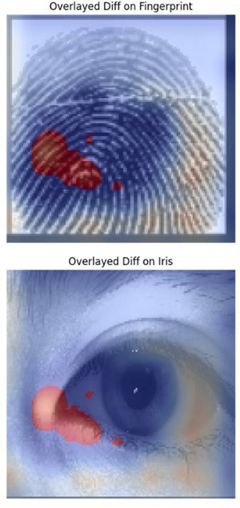
DIFFERENTIAL ATTENTION HEATMAP
Fingerprint vs. Iris Sensitivity:
CNN focused more on core ridges in fingerprints.
CNN emphasized pupil & boundary texture in iris.

Slide 21
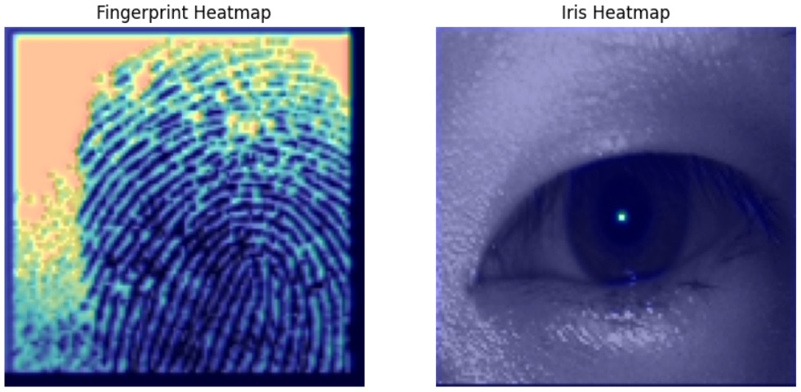

Slide 22
CONCLUSION & FUTURE WORK
Grayscale conversion for consistency.
Resizing (128×128 pixels) to standardize inputs.
Data Augmentation (rotation, noise addition) to improve generalization.
Key Takeaways
Multimodal biometrics improve accuracy & security.
CNNs effectively learn deep features from fingerprints & iris.
Feature fusion enhances classification performance.
Grad-CAM provides model interpretability for decision-making.

Slide 23
LIMITATIONS &
FUTURE RESEARCH
Grayscale conversion for consistency.
Resizing (128×128 pixels) to standardize inputs.
Data Augmentation (rotation, noise addition) to improve generalization.
Current Limitations
❌ Model trained on limited dataset.
❌ Needs real-time deployment testing.
❌ Faces challenges with occlusions & noise.
Future Enhancements:
✅ Add additional biometric modalities
✅ Train on larger, diverse datasets.
✅ Deploy model in a real-time biometric authentication system.

Slide 24
THANK YOU

